Slide 1
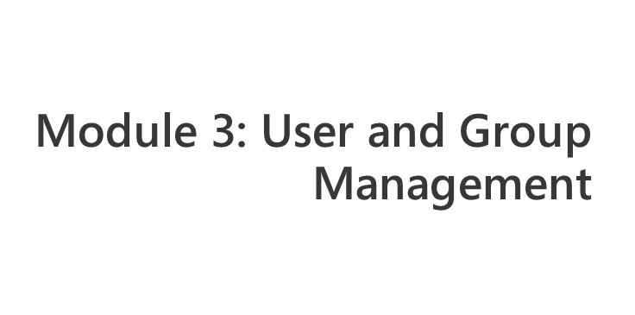
Notes:
Module x: Title
Course xxxxy
Presentation: xx minutes
Lab: xx minutes
This module helps students to ….
After completing this module, students will be able to:
Objective #1.
Objective #2.
Objective #3.
Required materials
To teach this module, you need the Microsoft Office PowerPoint® file xxxxy_xx.ppt.
Important It is recommended that you use PowerPoint 2002 or a later version to display the slides for this course. If you use PowerPoint Viewer or an earlier version of PowerPoint, all the features of the slides might not be displayed correctly.
Preparation tasks
To prepare for this module:
Read all of the materials for this module.
Practice performing the demonstrations and the lab exercises.
Work through the Module Review and Takeaways section and determine how you will use this
section to reinforce student learning and promote knowledge transfer to on-the-job performance.
If this is a KonaH product, use this section:
Make sure that students are aware that there are additional information and resources for the module on the Course Companion CD.
If this is a Forte product, use this section:
Make sure that students are aware that there are additional online resources for the module on the Course CD.

Slide 2
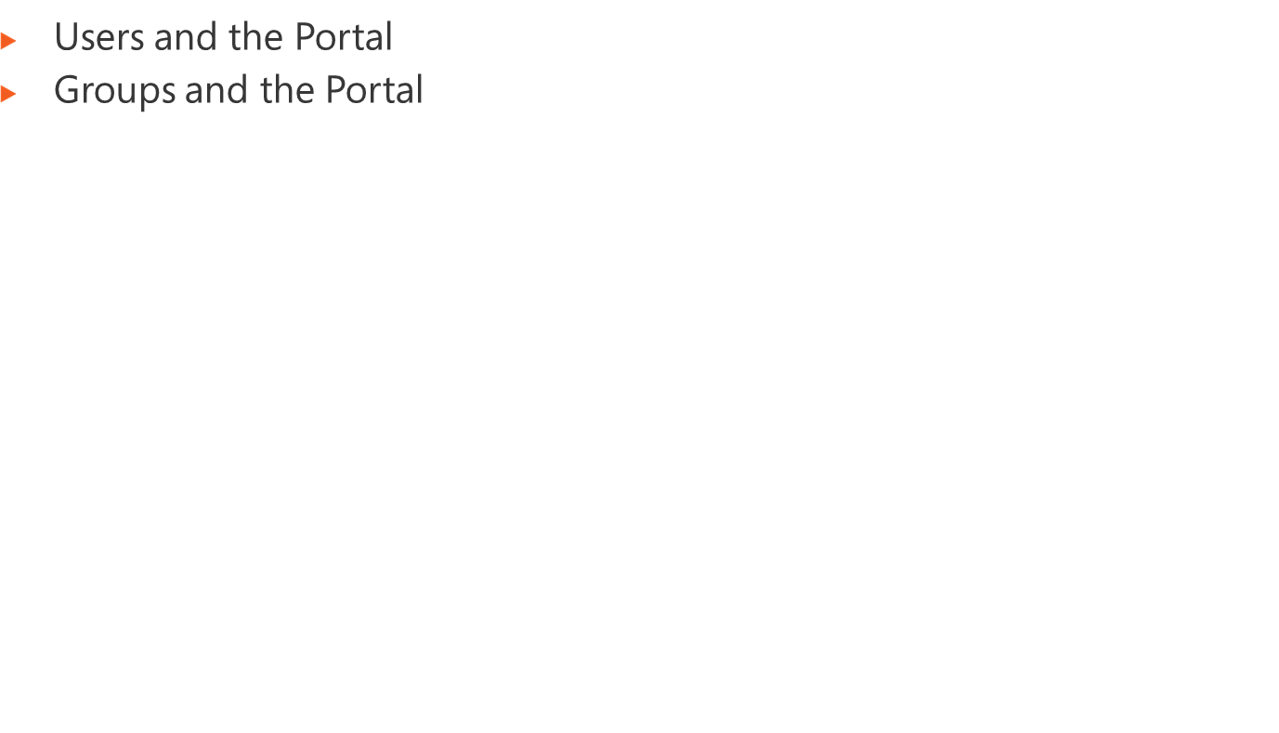
Notes:
Module x: Title
Course xxxxy

Slide 3

Notes:
Module x: Title
Course xxxxy

Slide 4
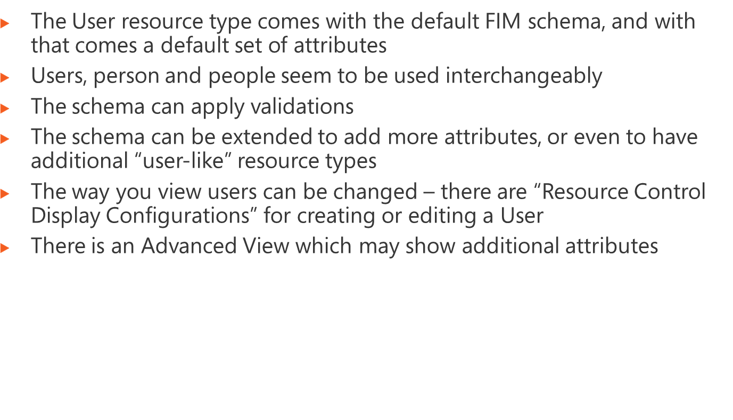
Notes:
Module x: Title
Course xxxxy

Slide 5
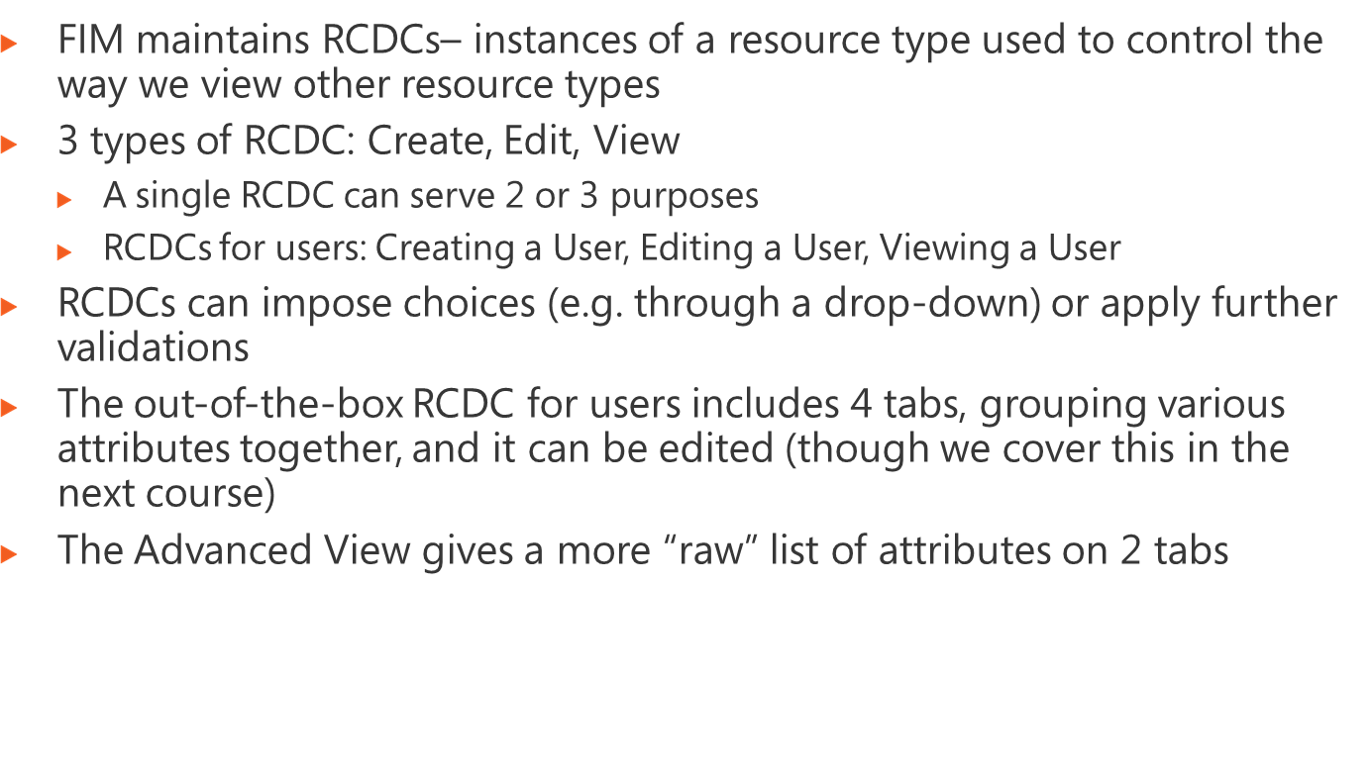
Notes:
Module x: Title
Course xxxxy

Slide 6
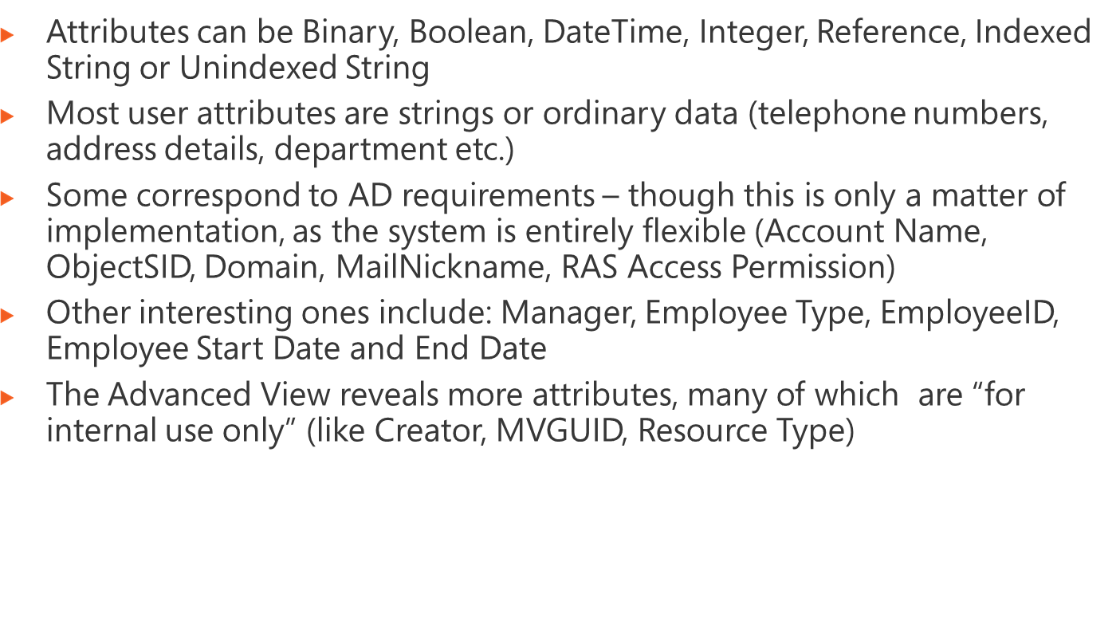
Notes:
Module x: Title
Course xxxxy

Slide 7
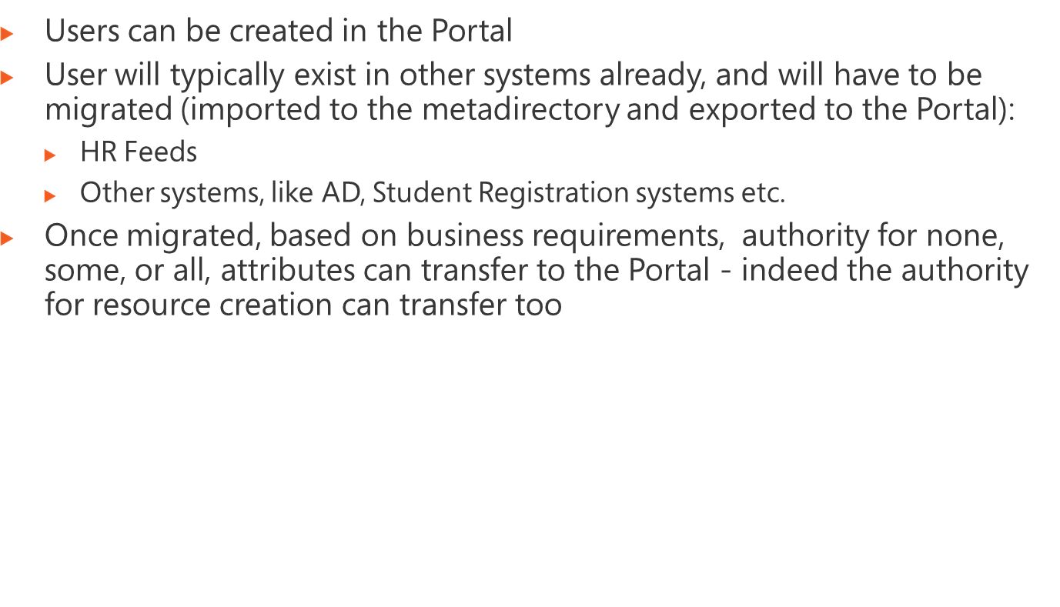
Notes:
Module x: Title
Course xxxxy

Slide 8
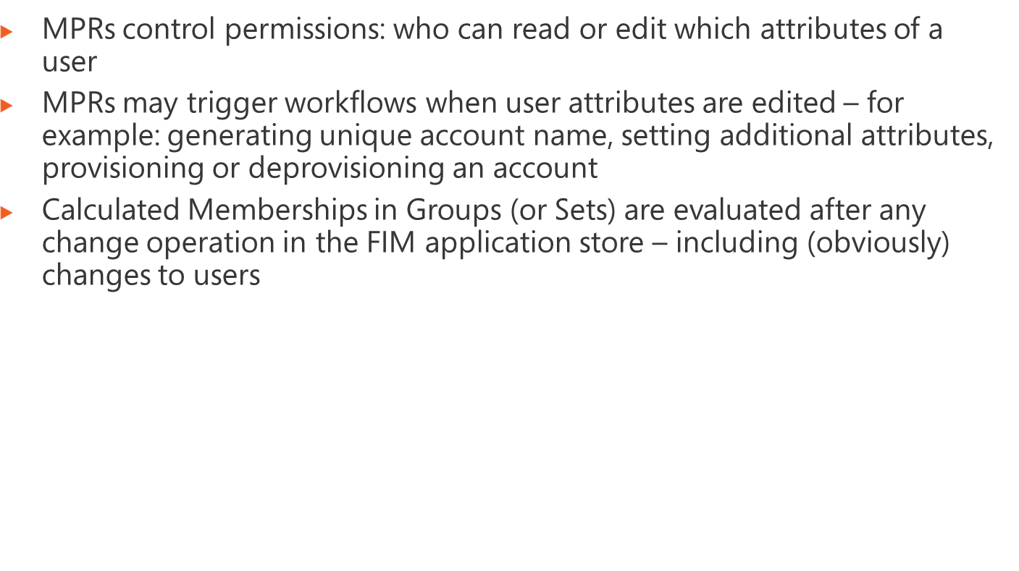
Notes:
Module x: Title
Course xxxxy

Slide 9
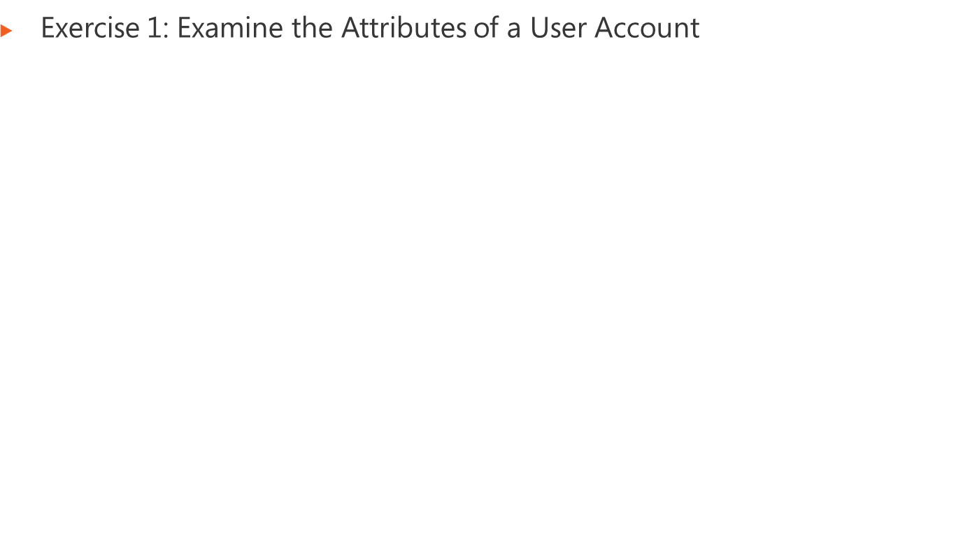
Logon information
Virtual machine | FIM2010RC1
User name | Administrator
Password | Pa$$w0rd
Estimated time: 45 minutes
Notes:
Module x: Title
Course xxxxy
In this lab, students will ….
Exercise 1
In this exercise, students ….
Exercise 2
In this exercise, students ….
Before the students begin the lab, read the scenario associated with each exercise to the class. This will reinforce the broad issue that the students are troubleshooting and will help to facilitate the lab discussion at the end of the module. Remind the students to complete the discussion questions after the last lab exercise.
If this is a KonaH product, use this note:
Note: The lab exercise answer keys are provided on the Course Companion CD. To access the answer key, click the link located at the bottom of the relevant lab exercise page.
If this is a Forte product, use this note:
Note: The lab exercise answer keys are provided on the Course CD.

Slide 10

Notes:
Module x: Title
Course xxxxy
Use the questions on the slide to guide the debriefing after students have completed the lab exercises.

Slide 11
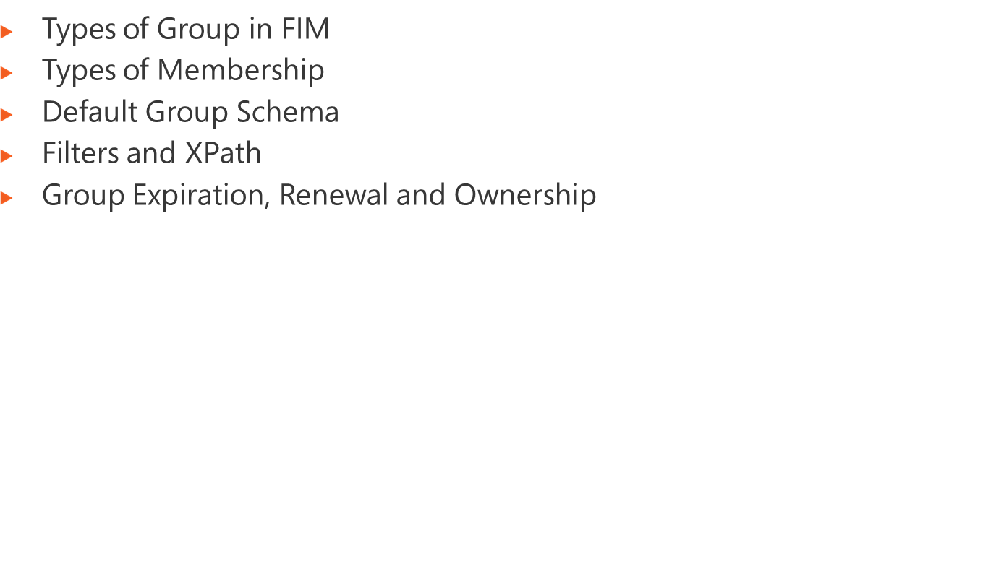
Notes:
Module x: Title
Course xxxxy

Slide 12
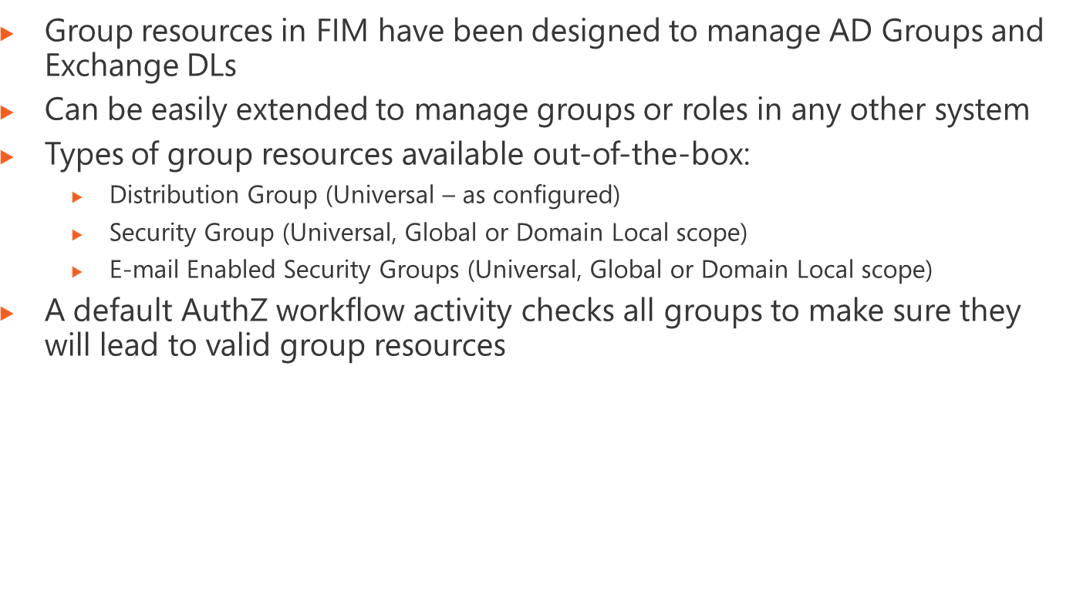
Notes:
Module 4: Managing Security
Course 2786B

Slide 13
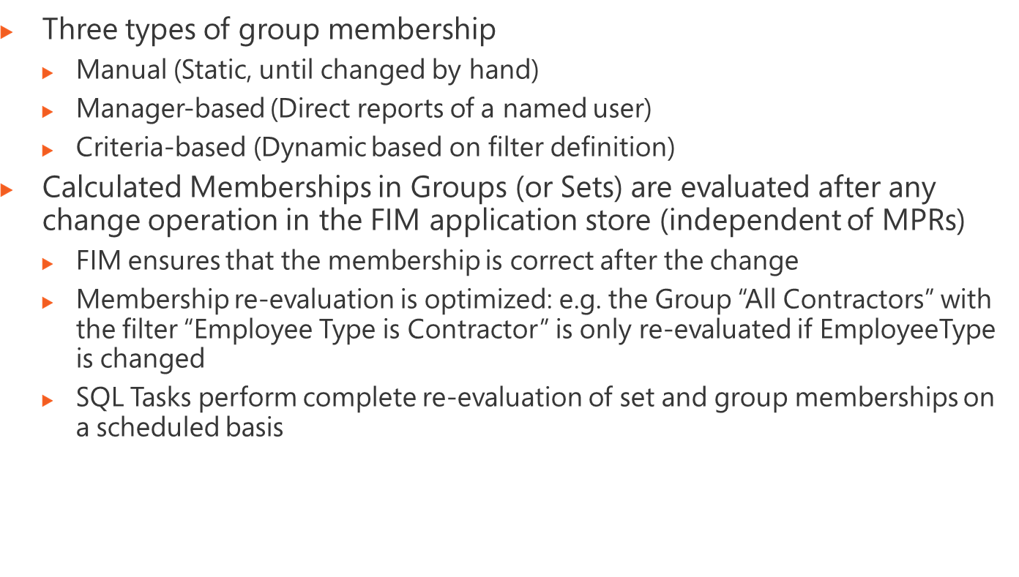
Notes:
Module 4: Managing Security
Course 2786B

Slide 14
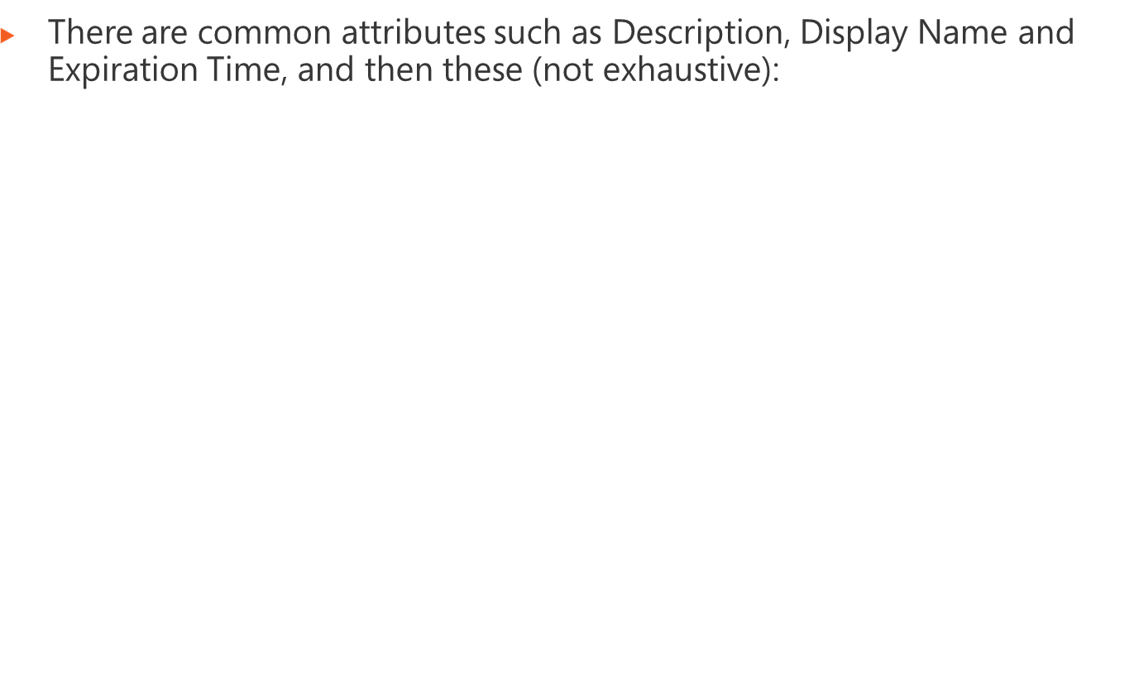
Account Name | Name of the group (expected to be flowed to sAMAccountName in AD)
Computed Member | Used internally and computed from the Manually-managed Membership and Filter attributes
Displayed Owner | Single valued attribute that is set in the owner attribute in AD and displayed in Outlook
Domain | AD Domain (simply a string)
Domain Configuration | A reference to a domain resource
E-mail | Used only for DLs and e-mail enabled security groups
E-mail Alias | Used only for DLs and e-mail enabled security groups
Filter | Defining the resources to be included as members of the group
Manually-managed Membership | Manually updated set of resources that contribute to Computed Member
Membership Add Workflow | Name of the process triggered when a member is added. Set by default to Owner Approval.
Membership Locked | Users can not be explicitly added or removed from locked groups (calculated groups are locked)
Owner | Multi-valued attribute containing the list of owners for the group. Approval requests would go to all these owners.
Resource SID | The SID which may be flowed back from AD
Scope | For DLs this is always set Universal. For Security groups it can be can be DomainLocal, Global or Universal
SID History | Flowed from AD if required
Temporal | Set to true when the filter used matches resources based on date and time attributes (and triggers updates based on time)
Type* | Security, MailenabledSecurity or Distribution
Notes:
Module 4: Managing Security
Course 2786B

Slide 15
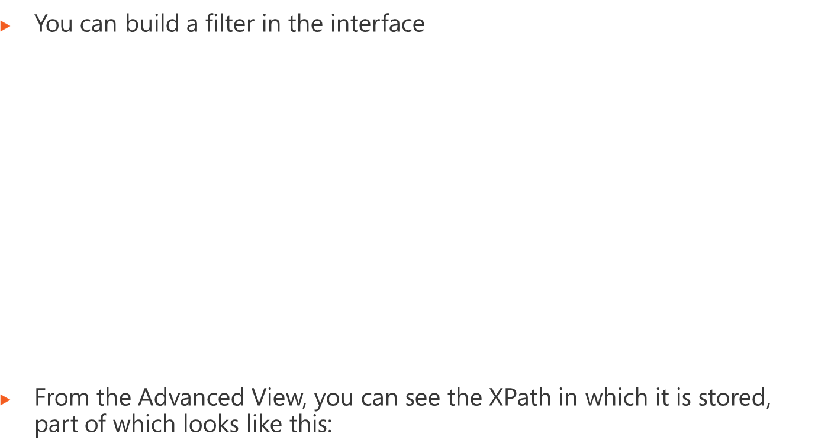
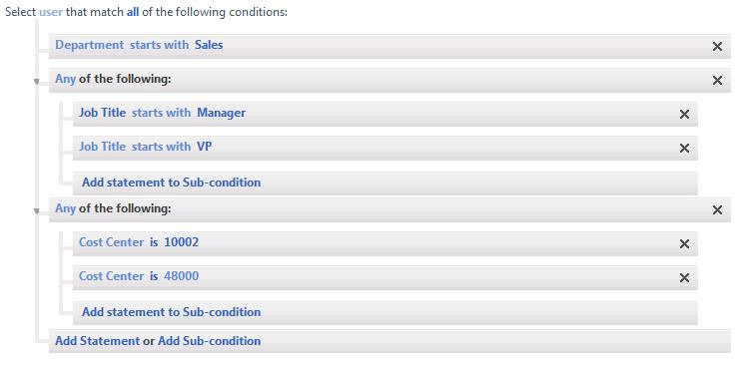
Notes:
Module 4: Managing Security
Course 2786B

Slide 16
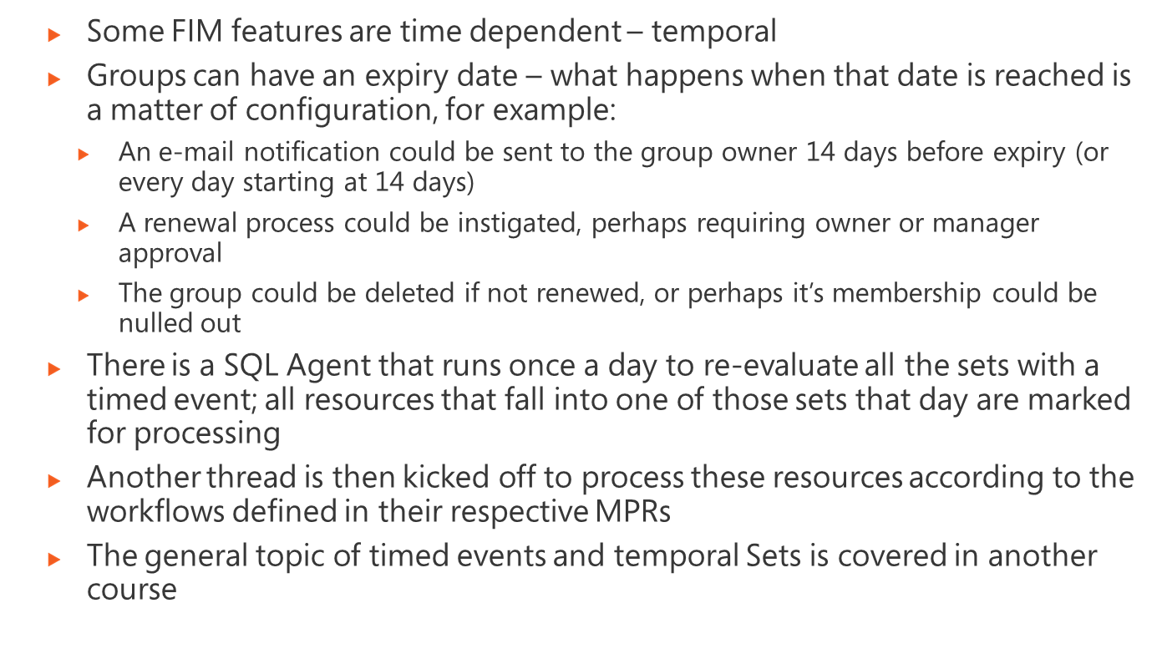
Notes:
Module 4: Managing Security
Course 2786B

Slide 17
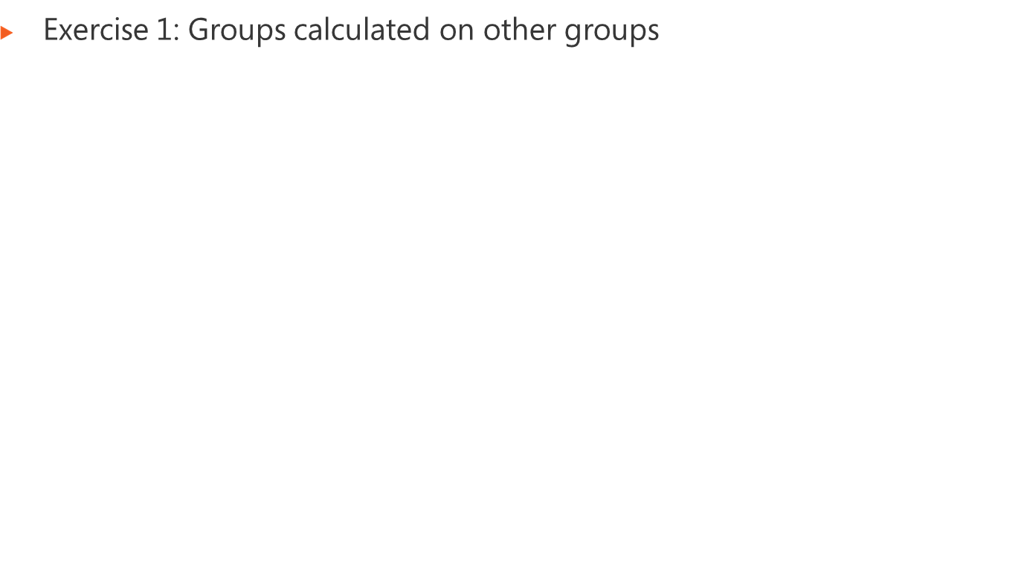
Logon information
Virtual machine | FIM2010RC1
User name | Administrator
Password | Pa$$w0rd
Estimated time: 30 minutes
Notes:
Module x: Title
Course xxxxy
In this lab, students will ….
Exercise 1
In this exercise, students ….
Exercise 2
In this exercise, students ….
Before the students begin the lab, read the scenario associated with each exercise to the class. This will reinforce the broad issue that the students are troubleshooting and will help to facilitate the lab discussion at the end of the module. Remind the students to complete the discussion questions after the last lab exercise.
If this is a KonaH product, use this note:
Note: The lab exercise answer keys are provided on the Course Companion CD. To access the answer key, click the link located at the bottom of the relevant lab exercise page.
If this is a Forte product, use this note:
Note: The lab exercise answer keys are provided on the Course CD.

Slide 18
Notes:
Module x: Title
Course xxxxy
Use the questions on the slide to guide the debriefing after students have completed the lab exercises.

Slide 19
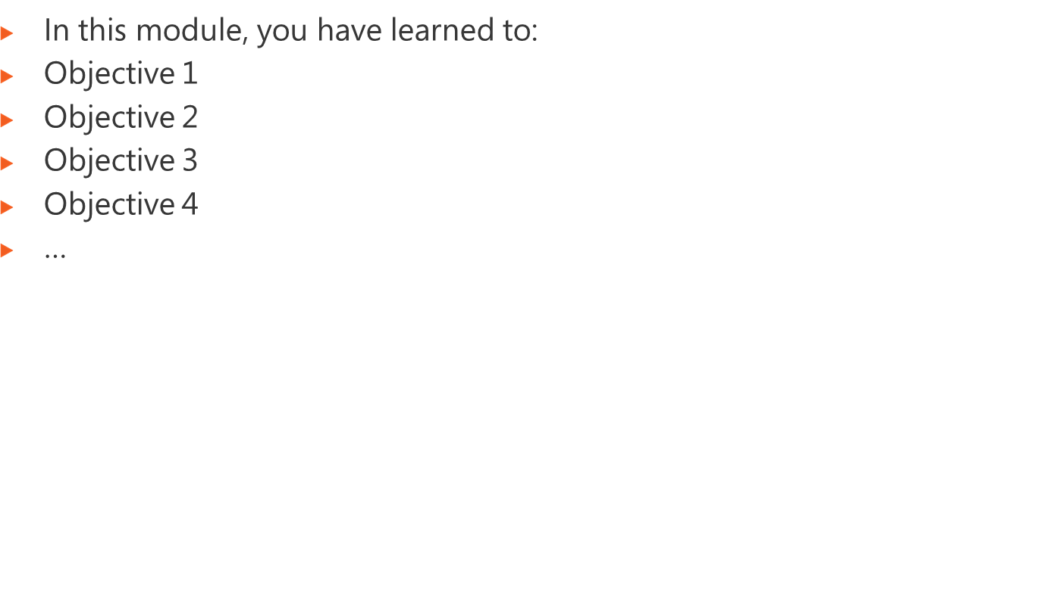
Notes:
Module x: Title
Course xxxxy

Slide 20
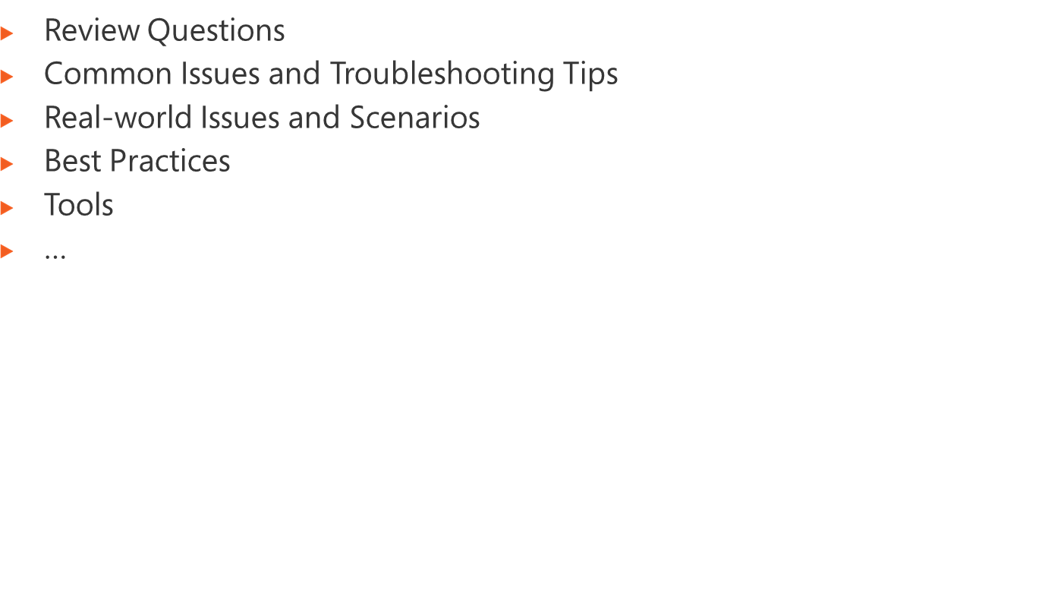
Notes:
Module x: Title
Course xxxxy
Review Questions
Point the students to the appropriate section in the course so that they are able to answer the questions presented in this section.
Common Issues Related to Desktop Application Support
Point the students to possible troubleshooting tips for the issues presented in this section.
Real-world Issues and Scenarios
You can either discuss possible solutions for the scenarios at the end of the module or assign these scenarios as homework for the students. If you assign the scenarios as homework, you should provide some high-level hints that might help the students solve the problem stated in the scenarios. You can also do a follow-up debriefing the following day on some of the scenarios that have been assigned as homework to students.
You can create high-level hints for each scenario by using the following possible solutions for the scenarios.
Scenario 1.
Solution 1.
Scenario 2.
Solution 2.
Scenario 3.
Solution 3.
Best Practices for Supporting Users Running Applications on Windows XP
Help the students understand the best practices presented in this section. Ask students to consider these best practices in the context of their own business situations.
Tools
Point out the location from which each key tool can be installed. Let students review the function and usage of each tool on their own. Remind students that they can use this as a master list to help them gather all the tools required to facilitate their application support work.

